Slide 1

Essentials of HTML

Slide 2
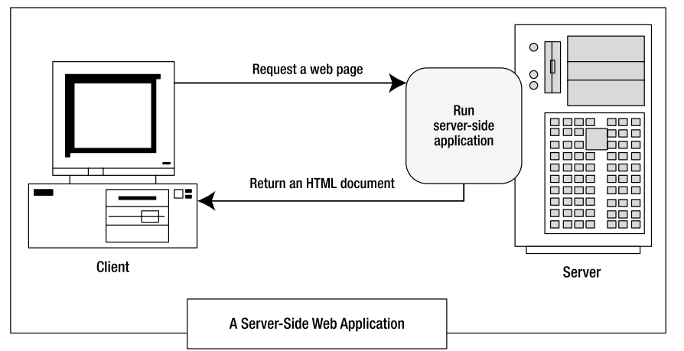
Introduction
When the page is processed by the web server, the ASP.NET web controls are converted to HTML markup (a process known as rendering) and inserted into the page. The ﬁnal result is a standard HTML document that’s sent back to the browser.

Slide 3
Elements
Elements are containers that contain bits of your web page content.
A typical element consists of three pieces:
a start tag, some content, and an end tag.
Here's an example:
<p > This is a sentence in a paragraph.</p>

Slide 4
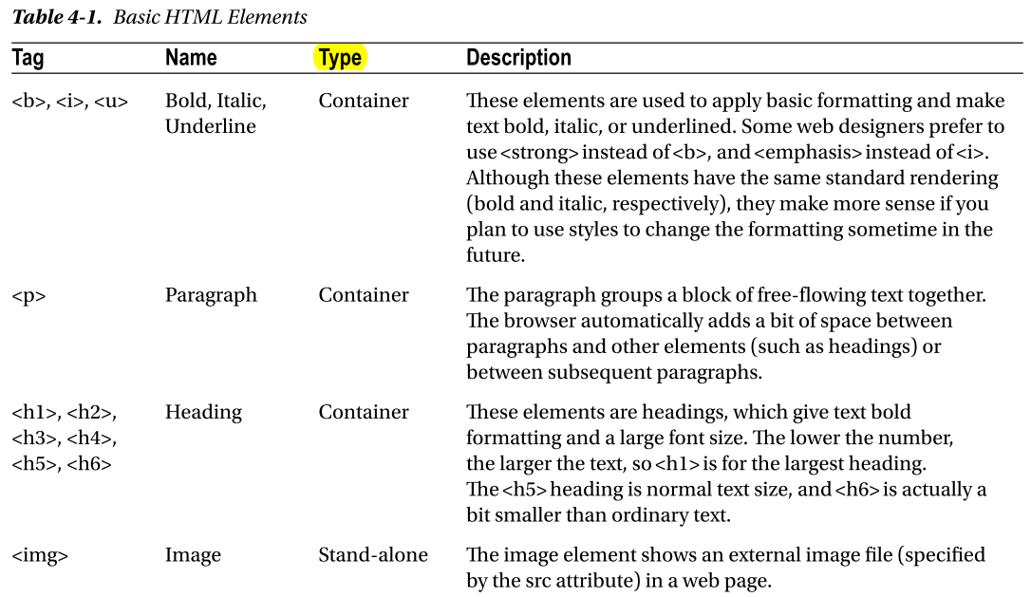
HTML Elements:

Slide 5
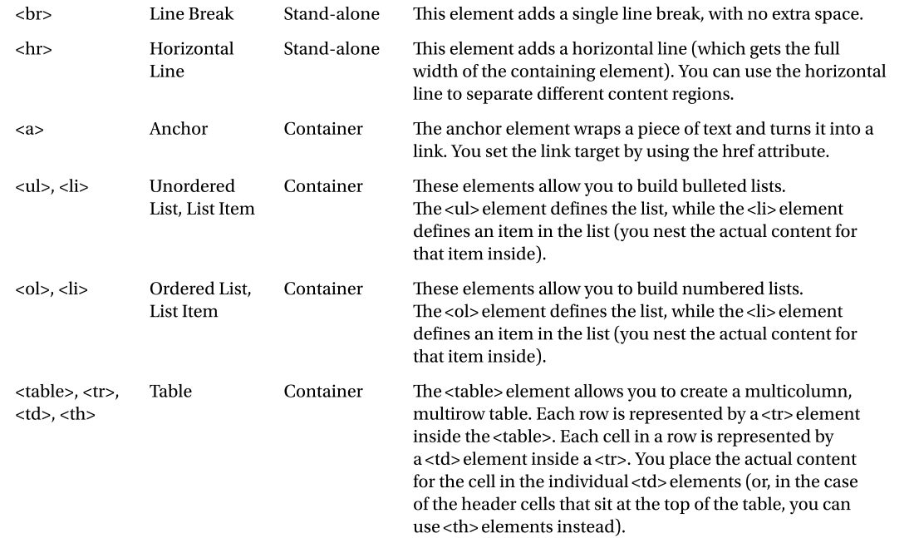
HTML Elements:

Slide 6
Attributes
Attributes are individual pieces of information that you attach to an element, inside the start tag
The <img> tag requires two pieces of information—the image URL (the source) and the alternate text that describes the picture .
<img src = "happy.gif" alt = "Happy Face" />
Click < a href = "http://www.prosetech.com">here</a> to visit my website.

Slide 7
A Complete Web Page
<html>
<head runat = "server">
<title > Untitled Page</title>
</head>
<body>
</body>
</html>

